Slide 1


Module 1: Me as a Leader

Slide 2
Module 1 Overview
Module 1 focuses on building a strong foundation of self‑awareness as the starting point for effective leadership.
Participants will explore who they are as leaders, what motivates them, and how their values, identity and lived experience shape their leadership behaviour and impact on others
The module invites you to reflect on your personal leadership journey so far, increasing awareness of strengths, motivators, conflict responses and potential self‑sabotaging patterns. You will consider how emotional intelligence, presence and personal impact influence relationships, decision‑making and team climate from day one.
We will explore what is important in leadership and how to apply different ways of leading to different situations, with a focus on creating psychological safety through how you show up, listen and engage.
You will deepen your understanding of self and others, and you will finalise and commit to your leadership goals as an authentic leader.
By the end of this module, you will:
Gain more self-awareness around your own values and leadership style, so you can grow as a leader
Know what has shaped your leadership journey so far, both professionally and personally
Understand different leadership styles and their impact on people and teams
Learn how to create the best environment for you and others to thrive in
Know how you need to manage your own health and wellbeing to be the best leader you can be
Share your journey and commit to your leadership goal(s), making the first steps
Learn from peers to have a greater insight into self, others, value differences and considering impacts

Slide 3
Day 1: Agenda
Topic | Agenda Items
Start | 09:30 | Welcome and start
Welcome and Connecting | 09:30 – 09:45 | Welcome and introduction to the day
 | 09:45 – 10:15 | Connection together
Building a picture of who I am | 10:15 – 11:15 | Who am I at my best
 | 11:15 – 11:45 | What shapes me
 | 11:45 – 12:15 | What do I want to be known for
Lunch | 12:15 – 13:00 | Lunch
What leadership style do I want to be | 13:00 – 13:30 | What is important in leadership
 | 13:30 – 14:00 | What are the different ways of leading
How can I be an authentic leader | 14:00 – 14:45 | Deep dive into the day's topic
Break | 14:45 – 15:00 | Break
Finalising my leadership goals | 15:15 – 16:00 | Finalising my leadership goals
Reflections and Close | 16:00 - 16:30 | Reflections and Close

Slide 4
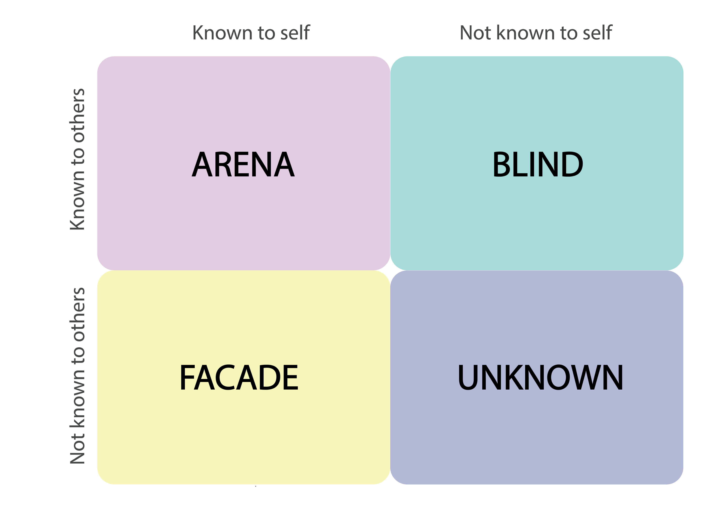
Johari Window
Feedback
The Johari Window is a self-awareness and communication framework divided into four quadrants (or panes):
Open Area: What you and others know about you.
Blind Spot: What others know about you, but you do not.
Hidden Area: What you know about yourself but choose not to share.
Unknown Area: What neither you nor others know yet.
The aim is to expand your Open Area through self-reflection, feedback, and trust-building, supporting personal and professional development.
Open Area
Blind Spot
Disclosure
Hidden Area
Unknown Area

Slide 5
Goleman’s Emotional Intelligence Model
Self Awareness
Social Awareness
How do I understand my thoughts and feelings and their effect on others?
Am I aware of my own strengths and limitations?
Do I have a strong sense of self worth?
Am I able to empathise with others?
How far am I aware of the needs and priorities of my organisation?
Do I understand the needs of patients, colleagues and partner organisations, and strive to meet these?
Goleman’s Emotional Intelligence Model
Self Management
Relationship Management
Can I control potentially distributive emotions and impulses?
How adaptable am I?
How important is achievement to me, and what kind of achievement matters the most?
Am I able to motivate myself?
How well do I manage my own stress?
Do I foster deep, lasting and meaningful relationships?
How far am I able to align with others and build collaborative teams?
Can I inspire and develop others?
How clear are my communications?
Can I identify and resolve conflict?

Slide 6
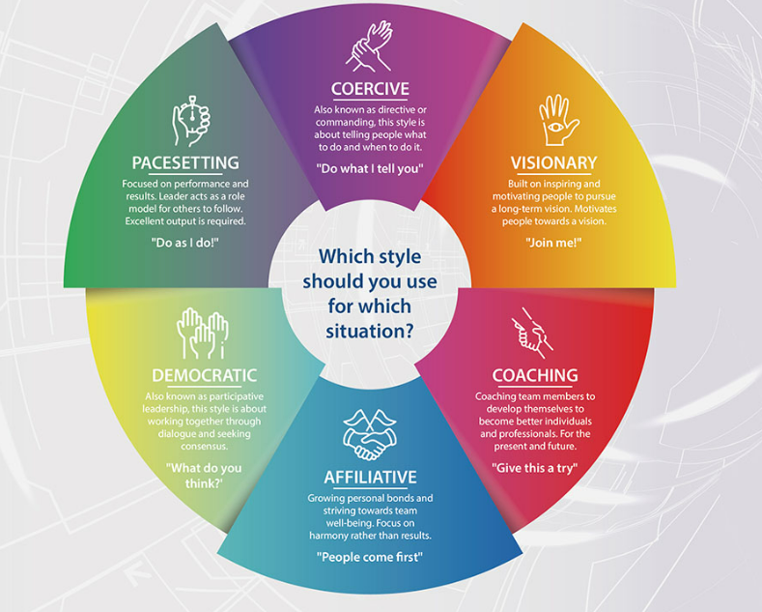
Golman’s Leadership Styles
Daniel Goleman’s six leadership styles are frameworks built on emotional intelligence.
Effective leaders avoid relying on just one; they fluidly shift between styles depending on the situation, the team’s needs, and organisational goals.

Slide 7
Preparation Activity: My Leadership Journey
Throughout the leadership development programme, you will be thinking about the leadership skills and behaviours you would like to develop.
A good way into this is to think about what has informed your leadership journey so far … the highs as well as some of things you wish you had done differently or had known more about at the time; the people and some of the events that took place.
Take some time to reflect on your journey into leadership. You can go back as far as you like– perhaps you were a natural leader as a child, or more recently you might have been encouraged to step into a leadership role or just knew that the time was right and so went for it! There are no rules – this is your journey.
And then, there is an opportunity to think into the future – how would you like that to pan out – use the template as a loose framework to help you plot this out.
We will work on these journeys during Module 1 as part of the ‘what shaped me’ session, so it would be helpful if you could do some thinking around this topic before this session. The templates on the next two pages are designed to help you with this task.

Slide 8




NOW
Key Roles
Key Events
Key People
What I was thinking & Feeling
Timeline

Slide 9
FUTURE LOOK
Key Roles
Key Events
Key People
What I was thinking & Feeling
Timeline

Slide 10
Additional Resources
Goleman’s Leadership Styles
https://content.leadershipacademy.nhs.uk/aspce3/files/Leadership_that_gets_results_goleman.pdf
Johari Window
https://www.hee.nhs.uk/sites/default/files/documents/Johari%20window.pdf
Podcasts
https://www.ted.com/talks/drew_dudley_everyday_leadership
https://www.ted.com/talks/karen_eber_how_your_brain_responds_to_stories_and_why_they_re_crucial_for_leaders We will be sharing our stories/leadership journeys at session 1

Slide 11
End of Document

