Slide 1
Module 1
Me as a Leader

Slide 2
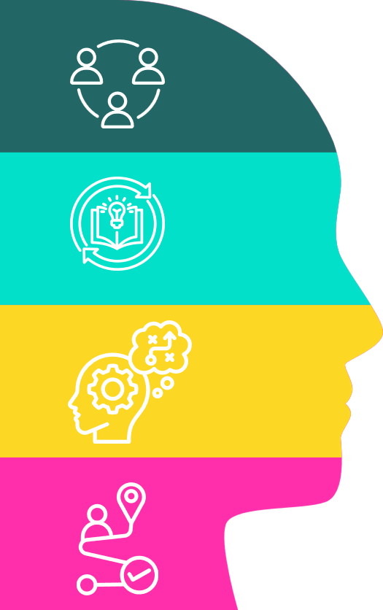

Objectives of Today
Building a picture of who you are
Reflect on who you are at your best, what has shaped you, and what you want to be known for.
Explore what leadership style you want to be
Identify what matters in leadership and explore different ways of leading.
Identify how you will be an authentic leader
Explore how you will be the best leader you can be and shape an environment where you and others can thrive.
Finalise your leadership goals
Share your journey, commit to your leadership goal(s), and start making the first steps.

Slide 3
Flow of the Day
Topic | Agenda Items
Start | 09:30 | Welcome and start
Welcome and Connecting | 09:30 – 09:45 | Welcome and introduction to the day
 | 09:45 – 10:15 | Connection together
Building a picture of who I am | 10:15 – 11:15 | Who are you?
 | 11:15 – 11:45 | What can you learn about you?
 | 11:45 – 12:15 | What do I want to be known for?
Lunch | 12:15 – 13:00 | Lunch
What leadership style do I want to be | 13:00 – 13:30 | What is important in leadership
 | 13:30 – 14:00 | What are the different ways of leading
How can I be an authentic leader | 14:00 – 14:45 | Deep dive into the day's topic
Break | 14:45 – 15:00 | Break
Finalising my leadership goals | 15:15 – 16:00 | Finalising my leadership goals
Reflections and Close | 16:00 - 16:30 | Reflections and Close

Slide 4
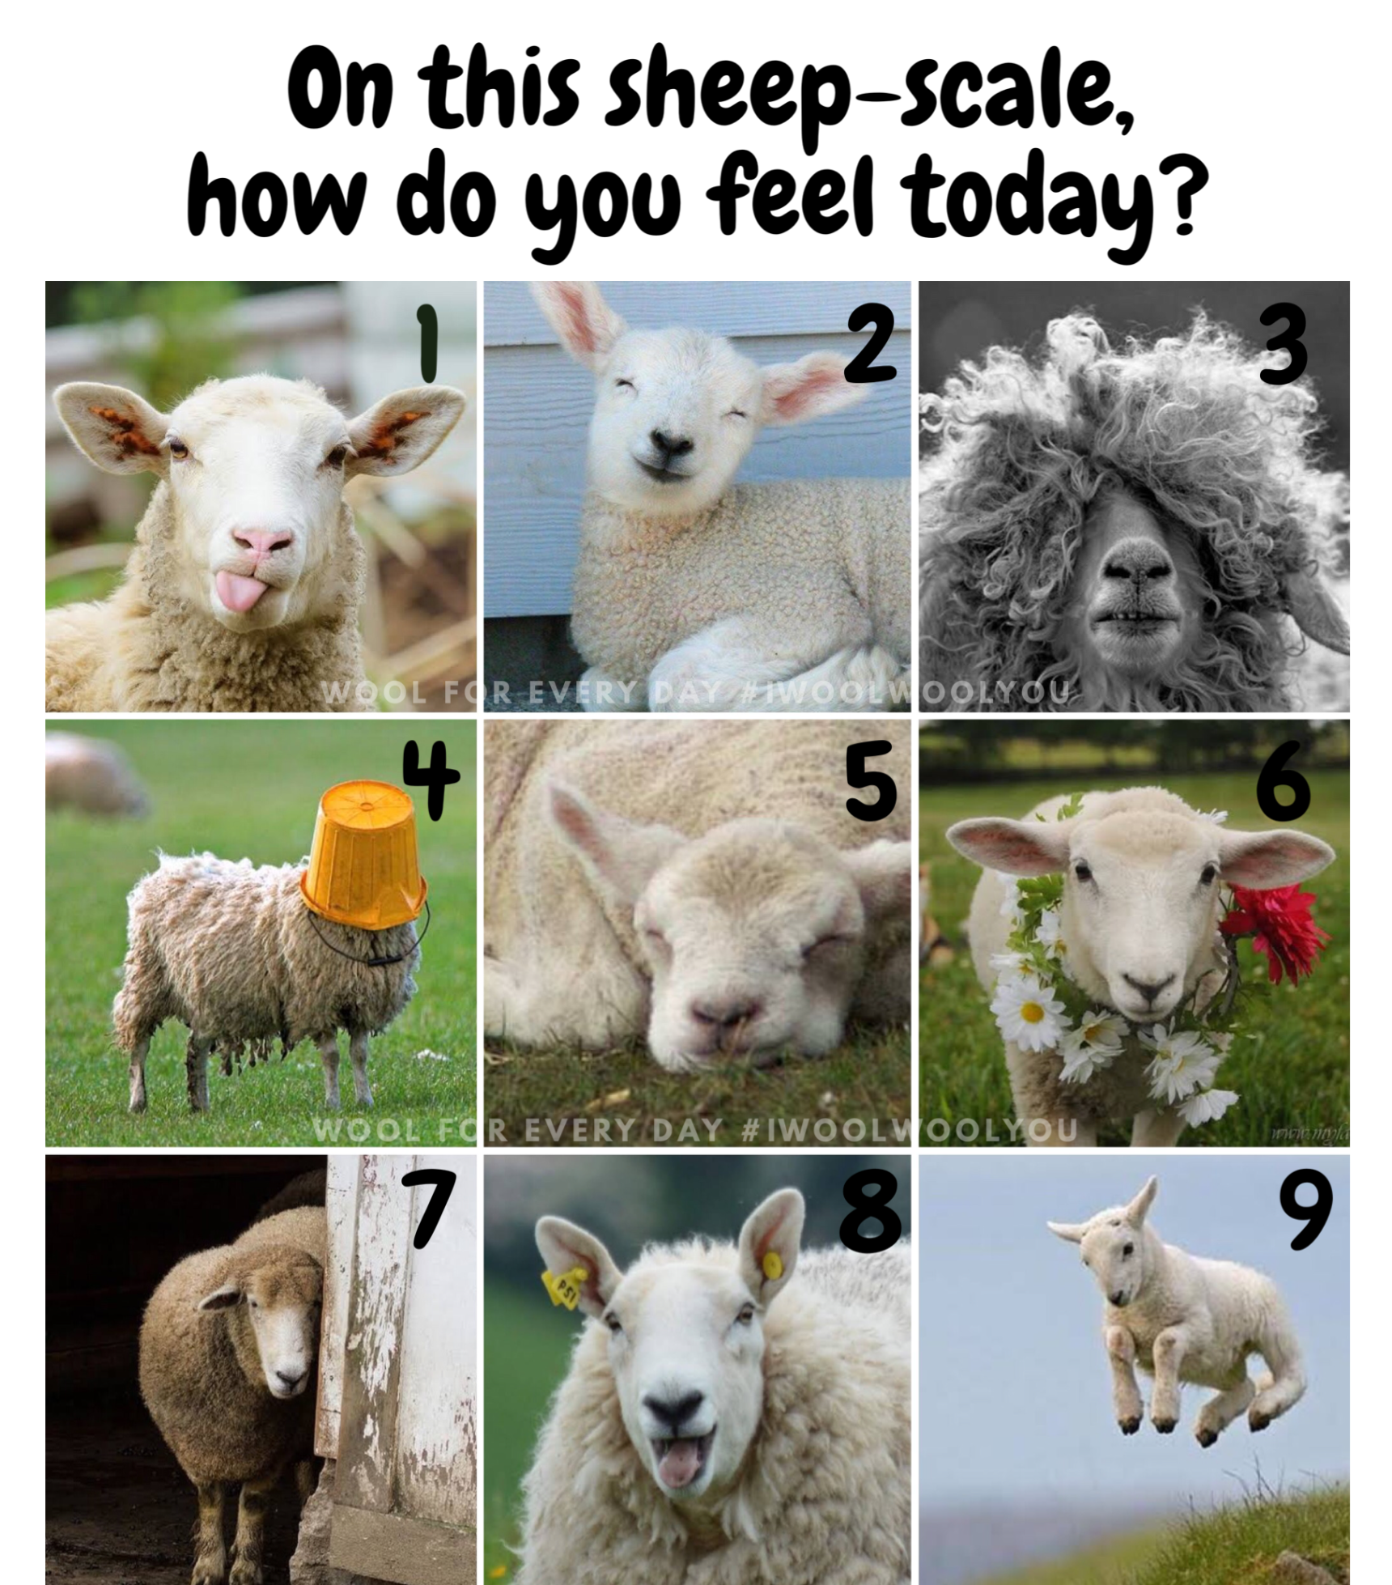
Connecting
Please could you:
Which number on this scale resonates today and why?
What are you most looking forward to about today

Slide 5


Building a picture of who I am

Slide 6
Who are you?
Knowing what shapes you helps you understand your professional identity, your strengths and the patterns that influence how you lead.
This show ups in how you:
Make sense of situations and solve problems
Build relationships and work with others
Respond under pressure
Learn and adapt
Show care, compassion and judgement
We are shaped and influenced by our:
Environment: The people, culture and conditions around you
Cognition: How you think, process information, are motivated and interact with the world.
Lived Experience: Your background, life experiences, culture and roles
Values: Your beliefs and what matters most to you

Slide 7
Who are you?
How do you interact with the world?
Processing
Purpose
What drives you?
Communication
Strengths
What conditions do you thrive in?
Motivation
Social connection
How do you hold yourself?
Physical
Emotional intelligence

Slide 8
Exercise
How do you interact with the world?
On your own, think about a real situation where you were at your best:
a. | What did it look like?
b. | What did it feel like for you?
c. | What conditions were around you?
d. | What impact did it have on others around you?
What conditions do you thrive in?

Slide 9
Exercise
How do you interact with the world?
Then in pairs, help your partner explore what they notice about themselves, including:
a. | How do you take in information and act on that
b. | How do you like to communicate
c. | What motivates you
d. | In your situation, what was the experience of others?
What conditions do you thrive in?

Slide 10
Plenary
How do you interact with the world?
What did you notice?
What conditions do you thrive in?

Slide 11
Exercise
In pairs, help each other to explore:
a. | What matters to you and why
b. | What motivates you?
c. | What are you top three strengths and how often do you get to use them?
What drives you?
How do you hold yourself?

Slide 12
What do I want to be known for?
Self Awareness
Social Awareness
How do I understand my thoughts and feelings and their effect on others?
Am I aware of my own strengths and limitations?
Do I have a strong sense of self worth?
Am I able to empathise with others?
How far am I aware of the needs and priorities of my organisation?
Do I understand the needs of patients, colleagues and partner organisations, and strive to meet these?
Goleman’s Emotional Intelligence Model
Self Management
Relationship Management
Can I control potentially distributive emotions and impulses?
How adaptable am I?
How important is achievement to me, and what kind of achievement matters the most?
Am I able to motivate myself?
How well do I manage my own stress?
Do I foster deep, lasting and meaningful relationships?
How far am I able to align with others and build collaborative teams?
Can I inspire and develop others?
How clear are my communications?
Can I identify and resolve conflict?

Slide 13
What can you learn about you?
Feedback
Leadership self-awareness grows through reflection, disclosure and feedback. The aim is to increase the open area and reduce blind spots.
The Johari Window is a self-awareness and communication tool with 4 areas:
Open Area: What you and others know about you.
Blind Spot: What others know about you, but you do not.
Hidden Area: What you know about yourself but choose not to share.
Unknown Area: What neither you nor others know yet.
Known to self
Not known to self
Open
Area
Blind Spot
Known to others
Disclosure
Hidden
Area
Unknown Area
Not known to others
Johari’s Window
Notes:
The Johari Window is a self-awareness and communication framework divided into four quadrants (or panes):
Open Area: What you and others know about you.
Blind Spot: What others know about you, but you do not.
Hidden Area: What you know about yourself but choose not to share.
Unknown Area: What neither you nor others know yet.
The aim is to expand your Open Area through self-reflection, feedback, and trust-building, supporting personal and professional development.
You increase what you know about yourself by inviting feedback from others. And you increase what they know about you by sharing information about yourself.

Slide 14
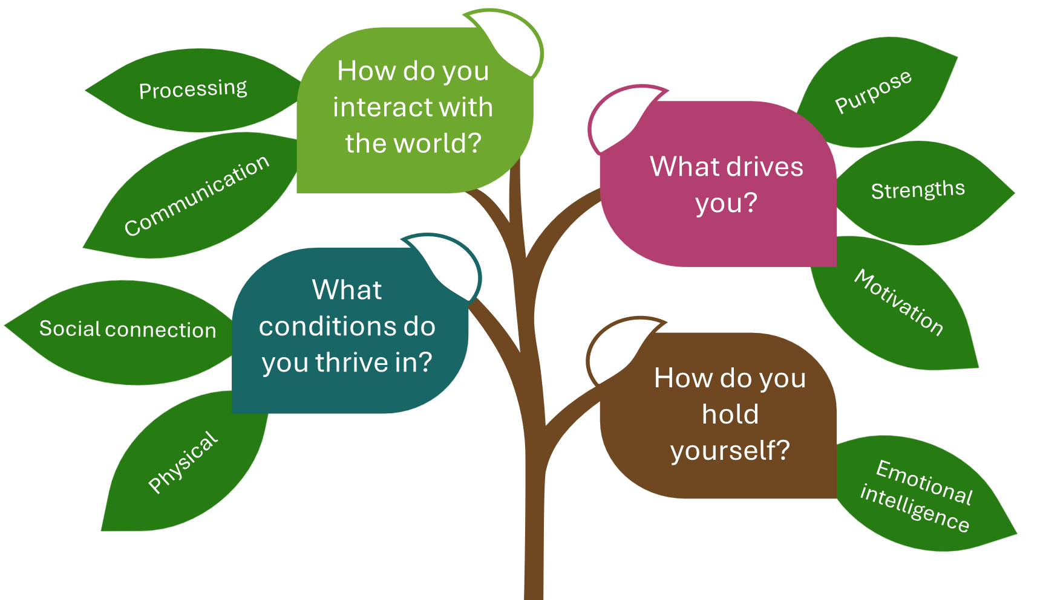
Exercise
Write down what you identified in the previous exercises in the:
  Open Area: What you and others know about you.
  Hidden Area: What you know about yourself but choose not to share.
In pairs, coach each other to explore what do you think others might appreciate, and what would you encourage each other to think about?

Slide 15
Johari’s Window
Known to self
Not known to self
Open Area
Blind Spot
Known to others
Hidden Area
Unknown Area
Not known to others

Slide 16
Lunch

Slide 17
What leadership style do I want to be?

Slide 18
What is important in leadership
In groups, pick a leader and identify what you think is important in their leadership approach, including:
What drives them and what is their purpose
How do they interact with the world
What conditions do they have around them
How do they hold themselves
What is their impact
Think about their:
  Skills
  Behaviours
  Characteristics
  What draws you to them

Slide 19
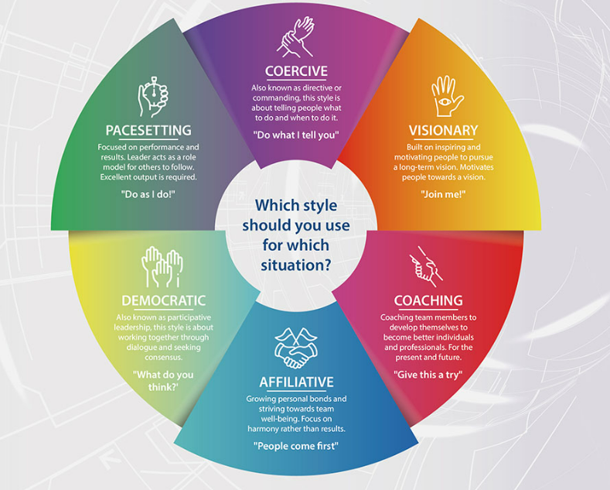
What are the different ways of leading
Daniel Goleman’s six leadership styles are frameworks built on emotional intelligence.
Effective leaders avoid relying on just one; they fluidly shift between styles depending on the situation, the team’s needs, and organisational goals.
Notes:
General points are:
Multiple styles
Portfolio of leadership skills and models
Be conscious of them, how and when to best use them
Resources for other styles
Expectations / characteristics - NHS wheel – NHS Framework

Slide 20
Leadership Styles
1. Self Awareness | 2. Social Awareness
Question: What is your preference of leadership style? | Question: What leadership style do you think your teams needs right now?
4. Relationship Management | 3. Self Management
Question: What do you think is the prevailing leadership style in the Trust? | Question: What do you notice about that?

Slide 21
How can I be an authentic Leader?
Deep Dive Groups

Slide 22
Authentic Leadership
To be an authentic leader, you build trust and connection by showing appropriate vulnerability, even though this can feel uncomfortable.
This is because we all face uncertainty, pressure and responsibility for others, regardless of role.
This naturally makes vulnerability part of everyday practice.
And how we feel at work affects how we think, behave and perform.
Emotions play a major role in communication, decision‑making and personal impact.
Leadership isn’t about a title or just what we do, it is about who we are.
Understanding who you are as an authentic leader starts with understanding ourselves, how our histories have shaped us, the lessons we’ve learnt along the way, and most importantly, our vulnerabilities.
People at work now are motivated by connection, belonging and purpose, not hierarchy or fear.
So in complex, pressured systems, the way you relate, respond and communicate is what shapes how people experience you.

Slide 23
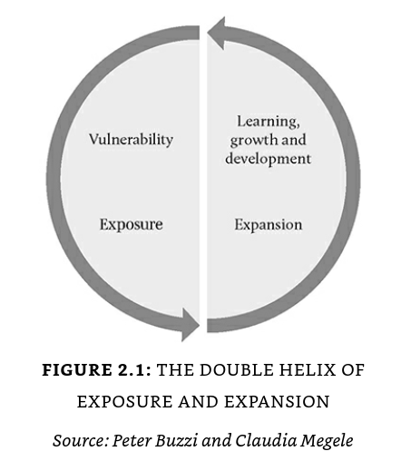
Vulnerable Leadership
The “Double Helix of Exposure and Expansion” shows the two sides of leadership vulnerability.
To use the currency of vulnerability, we need to:
Acknowledge the challenges and the difficult circumstances, and
Offer a vision and a way forward that leads to learning, growth, development and strength.
Vulnerability without expansion can increase anxiety. Vulnerability with direction builds confidence, connection and leadership impact.
Notes:
‘The Double Helix of Exposure and Expansion’, demonstrates the two sides of the coin.
“Imagine you’re part of a team meeting, you’re feeling overwhelmed and your manager is asking everyone to do more. You’re worried about burnout. But don’t want to say anything. But you know that this has lead to burn out before. So you speak up and say you feel overwhelmed,
That’s vulnerability, but without any direction.
And instead of helping, it can actually increase anxiety in the team. As they may feel it will be dumped on them.
What’s missing is the second part of the Double Helix — expansion: the reassurance, focus and sense of a way forward.
A more effective version might sound like:
‘This is a really pressured moment, and I feel it too.
Could we work together on prioritising and sharing out the work
Here, they’ve shared their vulnerability with steadiness and clarity — the two strands together.
That’s the Double Helix:
Exposure — being human, acknowledging the challenge
Expansion — offering focus, learning and forward movement
When we balance both, we build trust, connection and confidence — and that strengthens our leadership presence and personal impact.”

Slide 24
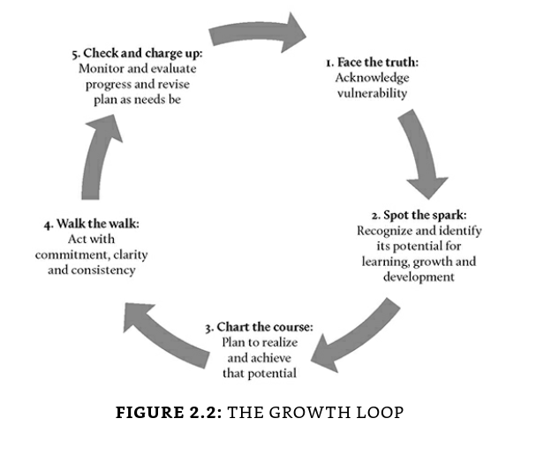
Leadership
When thinking about our own growth and development, we usually learn more from our setbacks, failures and other difficult experiences than most other experiences in our lives.
When we face vulnerability, especially in the workplace, we can take a step back to reflect on its potential for learning, growth and development.
The “Growth Loop” highlights the steps involved in tapping into the power of vulnerability and achieving its potential.
‘The first step in a growth policy is not to decide where and how to grow. It is to decide what to abandon’ Peter Drucker
Notes:
The “Growth Loop” highlights the steps involved in tapping into the power of vulnerability and achieving its potential.
We can think of this approach as a five-step process:
Face the truth: The first step is to acknowledge the vulnerability.
Spot the spark: The second step is to recognize and identify its potential for learning, growth and development.
Chart the course: The third step is to plan and outline in measurable terms how to realize that potential.
Walk the walk: The fourth step is to act on what we have planned. This can be daunting at times, as change doesn’t come easy, and it is often easier to fall back on old habits. So acting on our plan with commitment, constancy and consistency is key to harnessing the promise and potential of vulnerability.
Check and charge up: The fifth step is to evaluate and monitor our progress and to celebrate our achievements as we move along the path of realizing the potential of our vulnerability while remembering that no achievement is too small to celebrate.
When we face vulnerability, especially in the workplace, we can take a step back to reflect on its potential for learning, growth and development. Even when faced with a significant setback or failure, we can indicate what we’ve learnt from that experience and what we can do to mitigate or prevent similar occurrences in the future. Indeed, when thinking about our own growth and development, it can be said that most often we have learnt more from our setbacks, failures and other difficult experiences than most other experiences in our lives.

Slide 25
Finalising my leadership goals
Application Learning Groups

Slide 26
Reflections
Tomorrow

Slide 27
Objectives of Tomorrow
Define yourself as leader
Understand how you show up as a leader in your service environment
Explore your personal effectiveness
Identify what helps you, what holds you back, and what you need to develop to strengthen your personal effectiveness in clinical environments.
Identify how to identify development opportunities
Interpret service data to identify strengths, development areas and improvement opportunities
Strengthen your ability to lead
Strengthen your ability to lead quality, workforce and operational improvement in your team and service
Notes:
Building on day one, you will explore how you work in your service environment, identify your strengths and development areas, and build your self-awareness and personal effectiveness in clinical and service settings. Through reflection, discussion and practical exercises, you will consider how you show up as a leader and how this influences teams, culture and patient care.
You will reflect on your leadership strengths, behaviours and development needs in the context of organisational priorities. You will explore what supports you, what gets in the way, and what you need to develop, and consider how to apply this learning in your clinical leadership role through peer discussion and group work.
Intelligence Packs will support your reflection on leadership in clinical and service settings. They will help you understand your service context, interpret service data, and identify opportunities to improve quality, workforce and operational performance.

Slide 28
Close

