Slide 1
Programme Launch

Slide 2


Objectives of Today
Getting to know each other
Get to know and learn from your peers to have a greater insight into self and others.
Getting to know the Programme
Have a full understanding of the programme and an introduction to the GROW coaching model
Understanding the big picture
Be familiar with the key frameworks and the system you are working in
Shaping my journey
Map out what has shaped your leadership journey so far, and start to think about your leadership goal(s)

Slide 3
Flow of the Day
Topic | Agenda Items
Start | 09:30 | Welcome and start
Welcome and Introductions | 09:30 – 09:45 | Welcome and introduction to the day
Getting to know each other | 09:45 – 10:30 | Building a safe learning environment together
 | 10:30 – 11:00 | Connecting with my peers
Getting to know the Programme | 11:00 – 11:30 | Understanding our leadership programme
 | 11:30 – 12:00 | Understanding the GROW coaching model
Lunch | 12:00 – 12:45 | Lunch
Being part of the bigger picture | 12:45 – 13:45 | Mapping out the system and culture I am working in
 | 13:45 – 14:30 | Understanding the context and key frameworks
Break | 14:30 – 14:45 | Break
Shaping my journey | 14:45 – 15:00 | Keynote speaker
 | 15:00 – 15:30 | Mapping what has shaped my leadership journey so far
 | 15:30 - 16:00 | Starting to think about my leadership goals
Reflections and Close | 16:00 - 16:30 | Reflections and Close

Slide 4


Getting to know each other

Slide 5
Safe and productive learning environment
Facilitator’s role:
Keep to time and task
Make room for all views and keep us moving
Keep purpose front and centre
Remember:
We all learn
At different rates
In different ways
From different perspectives
So be patient, kind and manage self!
All contributions are valid
Observe the time frames
What’s said in the room, stays in the room – non attributable examples for the benefit of learning can be shared
Listening is encouraged
Curiosity is encouraged
Acknowledge differences and problems without working them!
Manage self
Focus on common ground

Slide 6
Meet & Greet Exercise
Find someone you don’t work with every day
  Introduce yourself and say how you got your first name
Both partners find another pair and as a four:
  Introduce each other with the name given and why it was given
Staying in your group of four:
  Share what you hope to get out of being in an environment where you can think about your leadership
  What do you hope to give
  What do you hope to receive to make this successful for you
Plenary Session
Something from each group on expectations (get out and put into the programme)

Slide 7
Getting to know the Programme

Slide 8
The Programme
The programme is a total of 10 days face to face learning, over a 6-month period.
Programme Launch
Module 1
Module 2
Module 3
Module 4
Module 5
Me as a Leader
Building Psychologically Safe, High Performing Teams
Setting Direction and Delivering Through Others
Inclusive Leadership & Anti-Racism in Practice
Integration and Executive Impact
Coaching Sessions

Slide 9
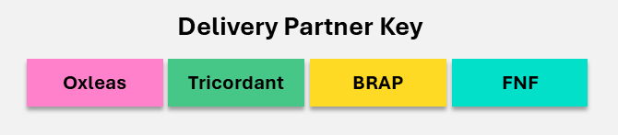
Content Overview
Delivered by the partnership of Tricordant, Florence Nightingale Foundation and BRAP. Prior to Programme Launch, Oxleas will hold a Readiness Session with participants Line Managers
Programme Launch | Module 1 | Module 2 | Module 3 | Module 4 | Module 5
 | Me as a Leader | Building Psychologically Safe, High Performing Teams | Setting Direction and Delivering Through Others | Inclusive Leadership & Anti-Racism in Practice | Integration and Executive Impact
1 day | 2 days | 2 days | 2 days | 2 days | 1 day
Day 1 | Day 1 | Day 1 | Day 1 | Day 1 | Day 1
Getting to know others, your programme and starting your leadership journey | Understanding who you are as a leader, and setting your leadership goals | Exploring how to create the conditions for high performing team and lead through complexity | Navigating priorities and goals, and how to set direction and deliver through others | Understanding how to lead inclusively in today’s context | Reflecting on your impact, celebrating your leadership journey and how you will lead going forward
 | Day 2 | Day 2 | Day 2 | Day 2
 | Understanding the impact you have as a leader and where you are heading | Developing your presence and impact, and how to communicate and respond effectively in different situations | Exploring personal ambition, and how to use coaching to support others to succeed
 | 3 x coaching sessions (Virtual) with Tricordant faculty

Slide 10
Programme Dates
 | Readiness Session (Line Managers) | Programme Launch | Module 1 | Module 2 | Module 3 | Module 4 | Module 5
 |  |  | Me as a Leader | Building Psychologically Safe, High Performing Teams | Setting Direction and Delivering Through Others | Inclusive Leadership & Anti-Racism in Practice | Integration and Executive Impact
Day 1 | 1st June 2026 12:30 – 1:30pm | 17th June 2026, 09:30 – 16:30 | 21st July 2026, 09:30 – 16:30 | 23rd September 2026 09:30 – 16:30 | 20th October 2026 09:30 – 16:30 | 24th November 2026 09:30 – 16:30 | 16th December 2026 09:30 – 16:30
Day 2 |  |  | 22nd July 2026, 09:30 – 16:30 | 24th September 2026 09:30 – 16:30 | 21st October 2026 09:30 – 16:30 | 25th November 2026 09:30 – 16:30

Slide 11
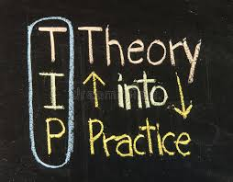
Approach
As a cohort, you will be
Learning with and from each other as you build your impact as a leader
Gaining a broader understanding of yourself, others, and the value of different perspectives
Exploring a mix of ideas through discussion, group work and individual reflect time based on your own experience
Considering leadership theories and practice and how these apply practically and in a grounded way to your day-to-day leadership.
Between modules …
We will encourage you to reflect on your learning and try things out in practice.
You will be supported by three one-to-one coaching sessions giving you protected time to step back, make sense of your experience and focus on what matters most for your development.

Slide 12
Day 1: Structure
Full Group
Group 2
Sub-Group 1a
Sub-Group 1b
Sub-Group 2a
Sub-Group 2b
Application Learning Groups
Group 1
The structure of Day 1 of each module is:
Morning
Everyone together
Presentation of theories and models followed by smaller group working (pairs, trios etc) to explore above.
Afternoon
Split into two groups
Topic Reflection – deeper dive: Further questions and personal reflection time, with facilitated discussion.
Split into four groups
Reflection on your leadership goals, and an opportunity over the programme to present a work scenario and receive peer support.
You will remain in the same Group and Sub-Group throughout

Slide 13
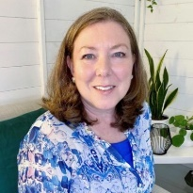
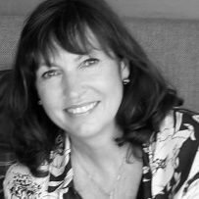
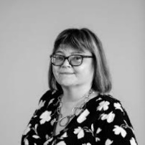
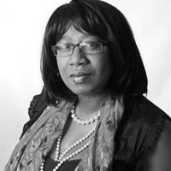

Facilitators and Coaches
 | Andrea Barker Facilitator and Coach
 | Helen Blanchard Facilitator and Coach
 | Yasmin Wills Facilitator and Coach
 | Jan Samuel Coach
 | Sonia Thompson Coach
 | Dino Laudato Coach
The programme is delivered by three partners working with Oxleas:
Oxleas
Tricordant
Oxlead Programme
Florence Nightingale Foundation (FNF)
BRAP

Slide 14

Programme Q&A

Slide 15


Slide 16
Primary
Task
Working
Secondary Task Working

Slide 17
The GROW Model
G
R
O
W
Application:
Leadership conversations
Team meetings
Coaching
Quick problem solving
You could take 10 minutes through to several sessions/ weeks to work through GROW
GOAL
Identify the desired outcomes or destination
What do you want to achieve?
Where do you want to be?
REALITY
Examine the current situation
Explore challenges, strengths and areas of opportunity
Identify working relational issues
OPTIONS
Explore potential strategies, solutions and paths to reach the goal
Try and think ‘out of the box’!
Influence, propose?
WILL
On a scale of 1-10 what is your Will to do this?
What specific steps will you take, and when?
How will you know you are making progress and stay accountable?
References
Alexander, G. (2010). Behavioural coaching – The GROW model. In J. Passmore (Ed.), Excellence in coaching: The industry guide (pp. 83–93).

Slide 18
Working with GROW
First: Individually, spend 3 minutes to think of a small work or home-based challenge you are experiencing – jot down a few points
Next: In pairs, hold a coaching conversation using GROW
    Speaker: Talk about your challenge
    Listener: Actively listen; use open ended prompting questions (be curious); and guide your speaker through the phases of GROW
Two Rounds, 10 minutes each way
Plenary: Share your reflections on what it was like using the GROW model.

Slide 19
Lunch

Slide 20
Mapping out the Systems

Slide 21
Mapping Exercise
First: On individual post-it notes write down the people, teams, groups etc. that make up your working environment: These are the groups that have an indirect and direct impact on how you deliver your services.
Next: Place the post-its on the wall/paper and, as a working group, start to map these concentrically

Slide 22

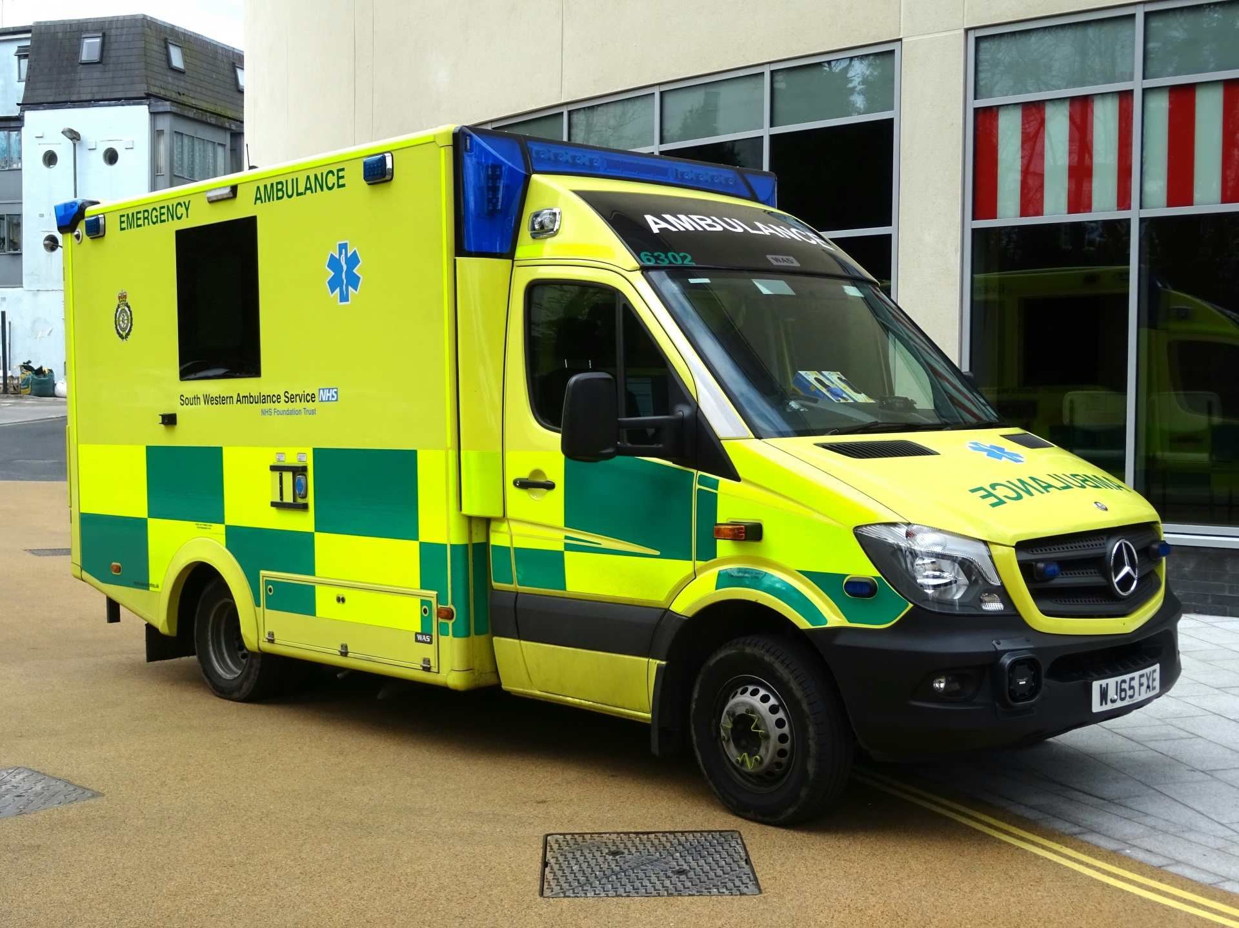



Example
Wards
Admissions
Porters
Acute Admissions for Children
Medical Secretaries
Community Outreach Team
Commissioners

Slide 23
Mapping Plenary
What does it feel like working in this system?
  Where are you?
  Who is around you?
  Which departments are in this system?
  Who has key relationships with whom?
  Where is the power?
  How does the money flow?
  Where are there tensions?
  Where are there alliances?
What is realistically within your control?
Where are the areas you need to influence and partner with?

Slide 24
System Theory
1. Whole Systems Structures: Three dynamics/operating structures
2. Human Systems Thinking: Tops, Middles and Bottoms – Barry Oshry
History: The Power Lab, The Organisation Workshop on Creating Partnership, and the When Cultures Meet Workshop.: In 2013 Barry Oshry launched the Worldwide Week of Partnership, during which Power and Systems trainers across the globe conducted pro-bono partnership events for education, charitable, advocacy, and service organisations in their local communities.
From their work and extensive learning, they came up with the Tops, Middles and Bottoms dynamics in organisations. Here is just a taster to start the thinking about your own systems at Oxleas and how you can navigate these.

Slide 25


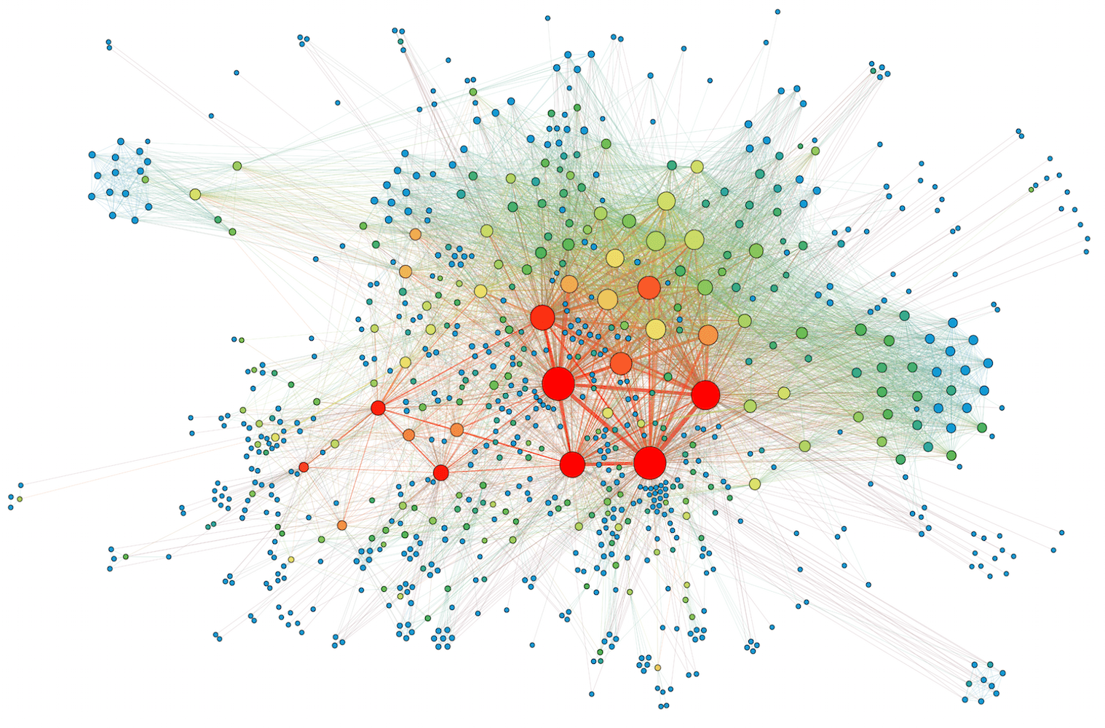
Three types of operating structures
Well oiled machine
Complex &
Adaptive Social

Slide 26
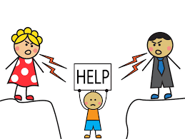





Human Systems thinking in Organisations
TOPS
MIDDLES
BOTTOMS
Designated authority at any level & the buck stops with us.
We need to get the rest of the team or system to support delivery.
Our name is in the action column
We experience conflicting demands, priorities and pressures from different sources.
We are a two-way conduit – we can be the oil or the jam in the sandwich!
When we are implementing at the front line and can experience problems with the system that we think “higher ups” should be taking responsibility for.

Slide 27
Three types of operating structures
Well oiled machine
Complex &
Adaptive Social

Slide 28
Be aware of
Pay Attention
Common Pitfalls
We all participate in multiple systems – team, directorate, organisations, community, wider systems
We all fulfil our roles – everyone has a part to play (lessen anxiety)
When relationships break-down it is about individuals
Reflective leadership practice is therefore as vital as reflective clinical practice
Top group members becomes dictatorial, territorial and fall into turf battles with each other – this damages accountability across the system
Middles becomes alienated from each other; they never become a group and lack influence
Bottom group members become a cohesive entity, “blame up” and pressurize each other into conformity/group think

Slide 29





Maximising Potential
TOPS
MIDDLES
BOTTOMS
DEVELOPER
INEGRATOR
FIXER

Slide 30
Being part of the bigger picture

Slide 31

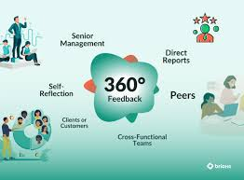
NHS Management and Leadership Programme
Unified, national framework launched to professionalise and standardise
leadership skills across the NHS. It is underpinned by the Leadership Code
For Health and Social Care
The programme has three workstreams:
Set the right standards for leaders and managers
Develop leadership and management
Talent support and career development
The framework has three key groupings:
Self effectiveness
Managing people and resources
Delivering across Health and Care

Slide 32
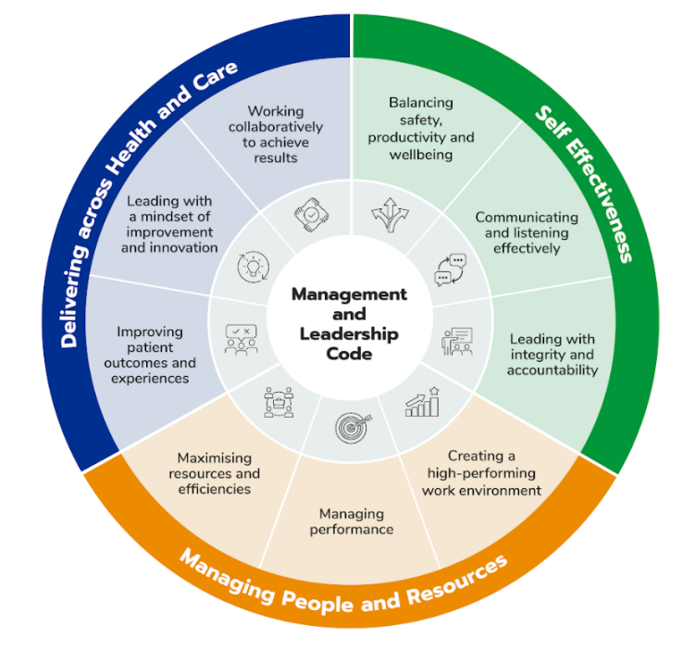
NHS Management and Leadership Framework
“Empowering current and future leaders to excel, delivering outcomes and supporting staff in driving the shift towards patient-centred community and neighbourhood-based care, preventative strategies, and innovative, digitally-enabled services”.

Slide 33
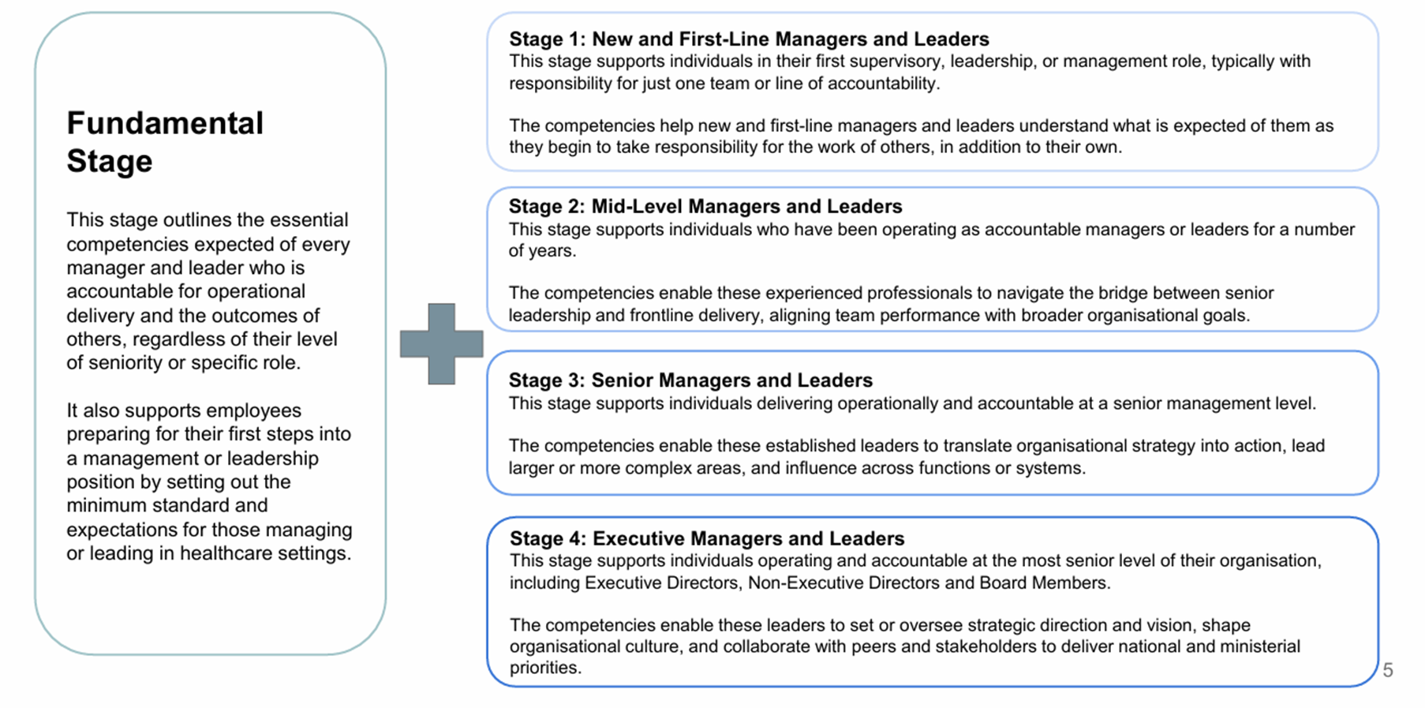
Draft stages of the framework

Slide 34
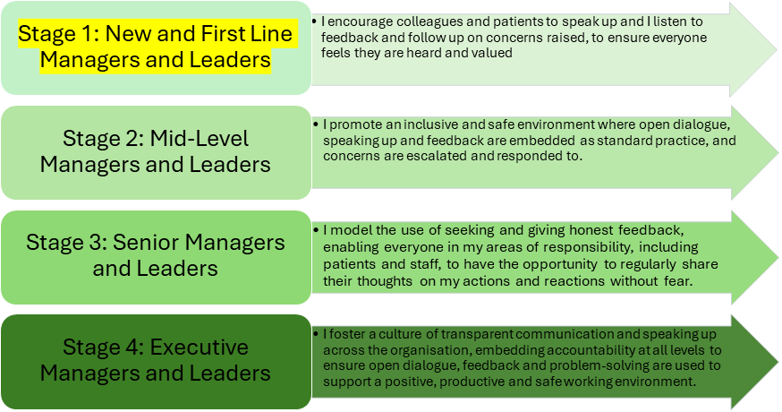
Self Effectiveness: Listening and Communication Effectively

Slide 35
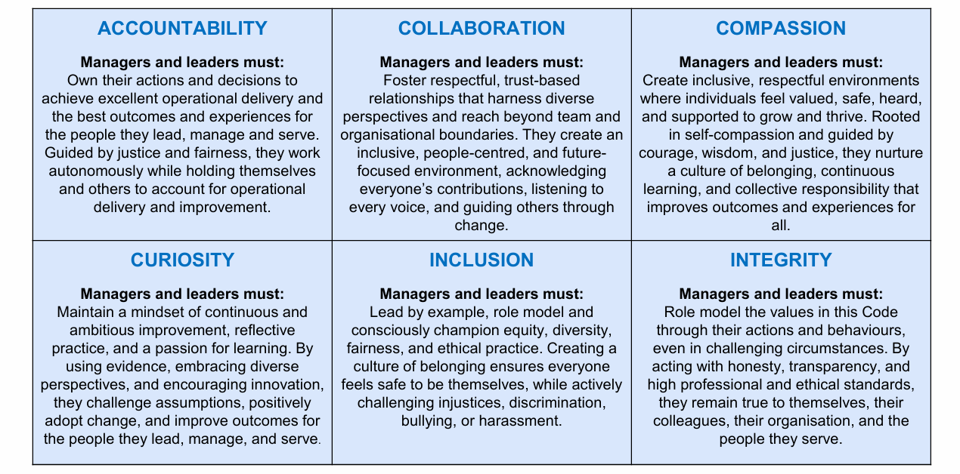
Draft management and leadership code

Slide 36
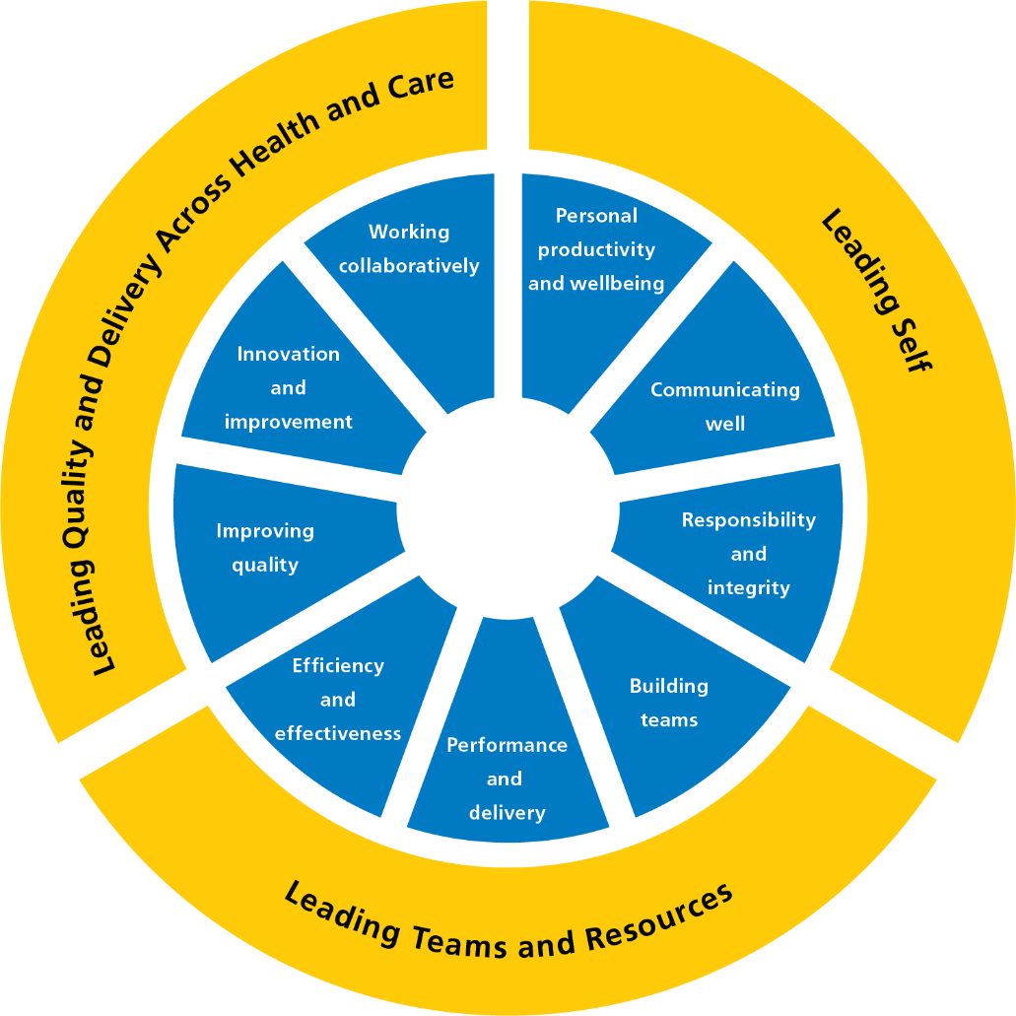
Oxleas ‘Our Leadership Way’
Our Leadership Way describes what good leadership looks like at Oxleas.
The framework applies to everyone with leadership or management responsibility
At Oxleas, we have translated this national framework into language and behaviours that reflect our values, our culture, and our strategic priorities.
Our Leadership Way connects the national expectations with what it means to lead well at Oxleas, ensuring leadership feels relevant, practical, and rooted in the Oxleas difference.

Slide 37
CQC Framework: Key Lines of Enquiry
Safe
Effective
Caring
Responsive
Well-led
Protect people from harm
Safeguarding
Risk management
Safe care
Medicines
Learning
Deliver evidence-based outcomes
Assess needs
Monitor outcomes
Skilled staff
Teamwork
Consent
Treat people with compassion
Respect & kindness
Involve people
Privacy & dignity
Meet individual needs
Person-centred
Equity of access
Timely care
Complaints
Ensure strong leadership
Leadership
Strategy
Culture
Governance
Improvement
This diagram summarises the five CQC Domains (Key Lines of Enquiry) and the sources of evidence for each of these.
Link to more detailed information: https://www.cqc.org.uk/guidance-providers/healthcare/key-lines-enquiry-healthcare-services

Slide 38

Oxleas Strategy 2024-27

Slide 39
Oxleas Strategy 2024-27
Our journey to continually improving lives… With you in the driving seat
We want everyone, wherever located, to feel the ‘ Oxleas difference’ — a distinct culture that is driven by our unique values.
The key priorities for 2024 – 2027 have been extracted from your strategy below for reference:
Great Care: We want Oxleas to be known for kind and compassionate care that puts patients right at the centre. We want to draw on the best in research and practice to improve our patients’ lives. Wherever possible, we want to equip our patients with the tools, skills and services they need to manage their conditions in their own communities.
Timely Care: The lives of our patients improve when they receive the right care at the right time. When they experience unnecessary delays in receiving care, their health can deteriorate. We are committed to doing everything we can to prevent this.
Best Place to Work: Our ambition is for Oxleas to be the best place to work in the NHS. We know that we can only deliver really great care to our patients if we are able to retain and attract high quality and engaged staff. Given the acute NHS staffing challenges, it is more important than ever that Oxleas stands out as an employer of choice where everyone feels included.
For each strategic priority, Oxleas has a vision and key cross-organisational programmes of work that are essential for meeting the strategic priority and vision. These are outlined on the following pages.
Notes:
Please can

Slide 40
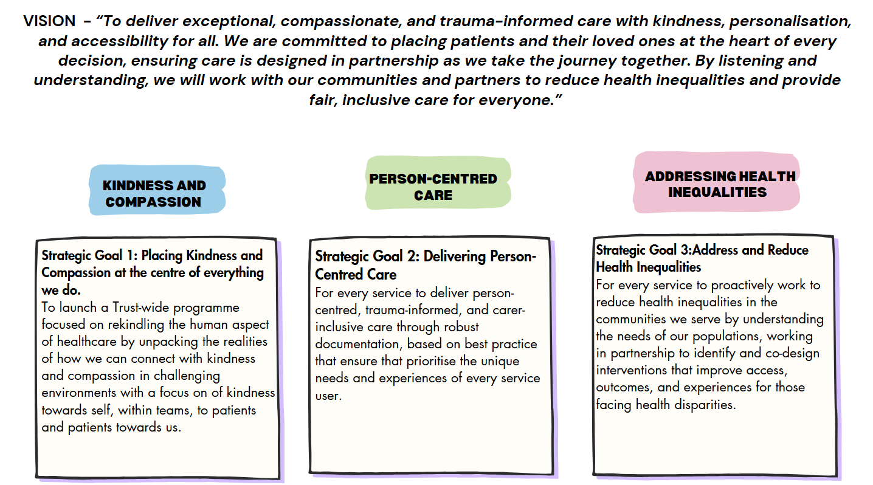
Oxleas Strategy: Great Care

Slide 41
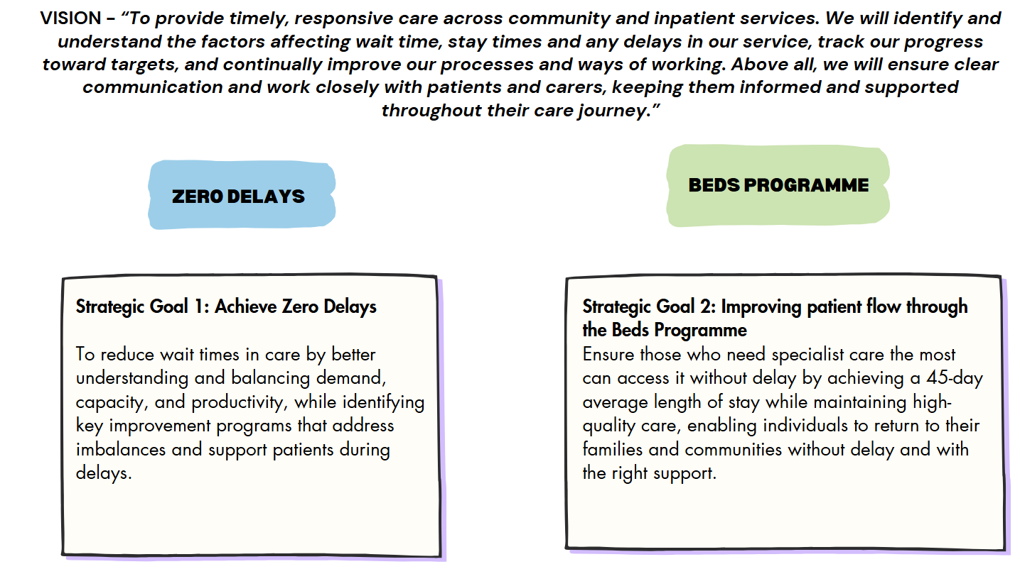
Oxleas Strategy: Timely Care

Slide 42
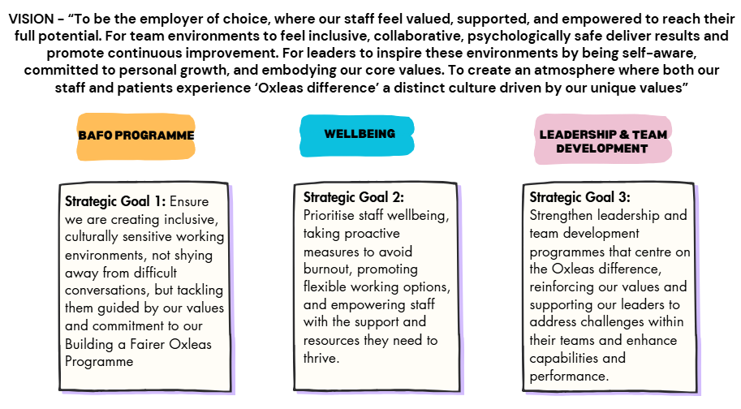
Oxleas Strategy: Best Place to Work

Slide 43
Theory into practice
First: Pick one of the three strategy statements or ‘our leadership way’ and go and stand next to your chosen statement/leadership way (four groups)
Next: In your group take turns to each talk about your experience of leadership related to that statement. I.e:
    What works well for me / my team?
    What needs improving and what would that look like?
    What does that mean for my leadership?
Then: In your group share your reflections for each of the questions and record key points on the flip chart.
After: Plenary - share your insights as a group.

Slide 44
Shaping my journey
ALG:
Foundation Session

Slide 45

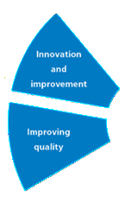
Introduction to learning logs

Slide 46
Application Learning
First: Personal reflection time
Note some of the standout things from today that have impacted your thinking and feeling about your role as a leader: e.g. from the strategy exercise, are there things you want to work on with your team or from the system leadership perspective, are there things you would like to do more of, less of, completely differently as you lead to make a difference.
Second: Starting to shape your leadership learning goals
Take it in turns to share your reflections so far with your ALG
ALG to listen, be curious and help your peers explore further what their leadership challenge (style, behaviour etc.) might be.
There is no pressure to pin this down today – take your individual thinking to your first coaching session. Your leadership goals will be informed by the module sessions, your strengths identification, your 360 and feedback you may have received from others.
In Module 2, be ready to share your identified goals with your ALG so that you can support each other in-between and during modules.

Slide 47
Cohort Check-out
& Close

