Slide 1
Programme Launch and Module 1
Pre-reading pack

Slide 2
Introduction
This is the briefing pack for participants in the OxLead First and Frontline Leaders Programme. This pack covers Programme Launch and Module 1 content.
The first section of the pack includes an introduction to the programme, setting out the high-level content for each module, together with the dates for Cohort 1.
The subsequent sections of the pack includes:
The draft agendas for the Programme Launch and Module 1, Me as a leader.
Information about the key theoretical models that we will be using, and
Links to further reading for participants who would like to explore these models in a little more depth before each session.
Section 1: Overview provides a high-level overview of the programme content, flow and dates for Cohort 1.
Section 2: Programme Launch includes the draft agenda, learning objectives and models to be used at the launch day on 17th June.
Section 3: Module 1 includes the draft agenda, learning objectives and models to be used during Module 1, together with some preparatory tasks.

Slide 3


Programme Overview

Slide 4
Programme Overview
The OxLead Early Leaders Programme aims to develop compassionate and inclusive leaders through an understanding of the Oxleas organisational values - we’re Kind, we’re Fair, we Listen and we Care.
It will support you to find your leadership voice, build effective and engaged teams and create safe environments where patient experience, improvement, innovation and performance are central to how we deliver high quality, compassionate patient care.
The programme is delivered through the partnership of Oxleas and three providers who will deliver expert and engaging content. These are:
Tricordant
The Florence Nightingale Foundation
BRAP
The programme overview and dates are shown on the next pages.
“Stepping into early leadership roles is both exciting and daunting, and we all need safe spaces to reflect, learn and grow. By knowing ourselves, seeking feedback and working from a shared understanding, leaders can balance compassion with accountability. OxLead will support our leaders to build strong relationships, adapt their leadership approach and develop high‑performing, happy teams. Most importantly, it provides a platform for leaders to genuinely enjoy their own leadership journey - strengthening our culture, quality, safety and wellbeing.”
Jane Wells
Chief Nursing Officer
“Our Oxlead programme is part of our commitment to delivering Great Care to our patients and ensuring that Oxleas is the Best Place to Work. The programmes will equip staff with the tools they need to improve patient care, work with families, our communities and system partners. It is an opportunity for professional and personal development of staff. We hope you enjoy what is being offered.”
Dr Abimbola (Abi) Fadipe
Chief Medical Officer

Slide 5
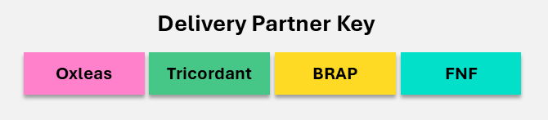
Content Overview
The programme is a total of 10 days face to face learning, over a 6-month period, delivered by the partnership of Tricordant, Florence Nightingale Foundation and BRAP. Prior to Programme Launch, Oxleas will hold a Readiness Session with participants Line Managers
Programme Launch | Module 1 | Module 2 | Module 3 | Module 4 | Module 5
 | Me as a Leader | Building Psychologically Safe, High Performing Teams | Setting Direction and Delivering Through Others | Inclusive Leadership & Anti-Racism in Practice | Integration and Executive Impact
1 day | 2 days | 2 days | 2 days | 2 days | 1 day
Day 1 | Day 1 | Day 1 | Day 1 | Day 1 | Day 1
Getting to know others, your programme and starting your leadership journey | Understanding who you are as a leader, and setting your leadership goals | Exploring how to create the conditions for high performing team and lead through complexity | Navigating priorities and goals, and how to set direction and deliver through others | Understanding how to lead inclusively in today’s context | Reflecting on your impact, celebrating your leadership journey and how you will lead going forward
 | Day 2 | Day 2 | Day 2 | Day 2
 | Understanding the impact you have as a leader and where you are heading | Developing your presence and impact, and how to communicate and respond effectively in different situations | Exploring personal ambition, and how to use coaching to support others to succeed
 | 3 x coaching sessions (Virtual) with Tricordant faculty

Slide 6
Programme Dates
 | Readiness Session (Line Managers) | Programme Launch | Module 1 | Module 2 | Module 3 | Module 4 | Module 5
 |  |  | Me as a Leader | Building Psychologically Safe, High Performing Teams | Setting Direction and Delivering Through Others | Inclusive Leadership & Anti-Racism in Practice | Integration and Executive Impact
Day 1 | 1st June 2026 12:30 – 1:30pm | 17th June 2026, 09:30 – 16:30 | 21st July 2026, 09:30 – 16:30 | 23rd September 2026 09:30 – 16:30 | 20th October 2026 09:30 – 16:30 | 24th November 2026 09:30 – 16:30 | 16th December 2026 09:30 – 16:30
Day 2 |  |  | 22nd July 2026, 09:30 – 16:30 | 24th September 2026 09:30 – 16:30 | 21st October 2026 09:30 – 16:30 | 25th November 2026 09:30 – 16:30

Slide 7
Programme Launch

Slide 8
Programme Launch Overview
The programme launch marks the start of your leadership journey, where you will build a safe learning environment with your peers, understand the arc of the programme and the context you are working in, and begin to shape your leadership journey.
You will connect with your peers and build relationships that support open, honest learning and reflection. Through shared discussion, you will gain insight into yourself and others, developing a deeper understanding of different values, perspectives and how these influence leadership and impact.
The day provides a clear overview of the programme and the key themes that will run throughout your leadership journey, from what has shaped your leadership so far to how this continues to evolve and how you see yourself as a leader over time.
You will explore the key frameworks that underpin leadership within Oxleas, alongside the wider system and organisational context you are working in, helping you understand how your role connects to broader priorities.
You will begin to shape your leadership journey by identifying areas you want to focus on and starting to think about your leadership goals.
By the end of this module, you will:
Get to know your peers and build a safe learning environment with them
Have a full understanding of the programme
Be familiar with the key frameworks, such as NHS Leadership Framework
Understand the system you are working in
Know you need to identify your leadership goal(s) and start to think about this
Learn from your peers to have a greater insight into self, others, value differences and considering impacts

Slide 9
Agenda
Topic | Agenda Items
Start | 09:30 | Welcome and start
Welcome and Introductions | 09:30 – 09:45 | Welcome and introduction to the day
Getting to know each other | 09:45 – 10:30 | Connecting with my peers
 | 10:30 – 11:00 | Building a safe learning environment together
Getting to know the Programme | 11:00 – 11:30 | Understanding our leadership programme
 | 11:30 – 12:00 | Understanding the GROW coaching model
Lunch | 12:00 – 12:45 | Lunch
Understanding the big picture | 12:45 – 13:45 | Understanding the context and key frameworks
 | 13:45 – 14:30 | Mapping out the system and culture I am working in
Break | 14:30 – 14:45 | Break
Shaping my journey | 14:45 – 15:30 | Mapping what has shaped my leadership journey so far
 | 15:30 - 16:00 | Starting to think about my leadership goals
Reflections and Close | 16:00 - 16:30 | Reflections and Close

Slide 10

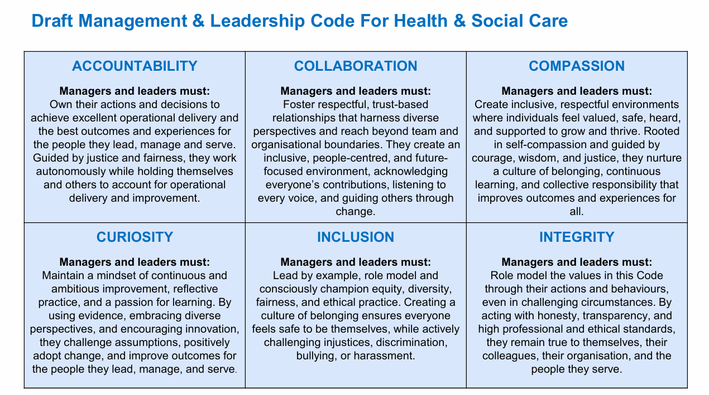
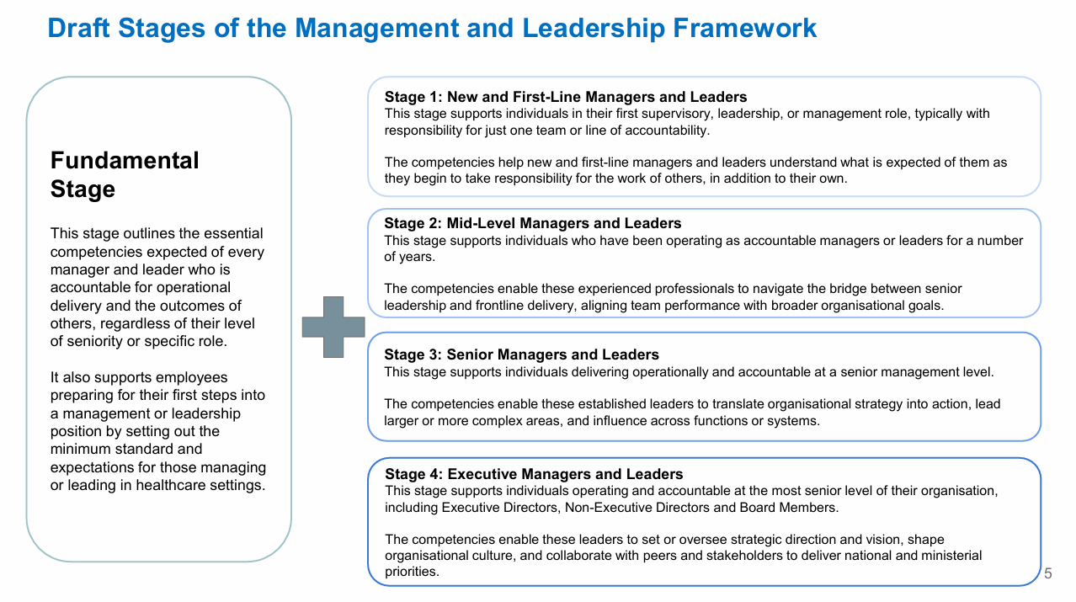
NHS Management and Leadership Programme
The new NHS Management and Leadership Programme is a unified, national framework launched to professionalise and standardise leadership skills across the NHS.
Initiated in response to key independent reviews, it introduces a mandatory Code of Practice and consistent competency benchmarks. It is designed to ensure all leaders and managers receive the development and support they need to improve patient outcomes.
The programme has three workstreams:
Set the right standards for leaders and managers: Implementing a new NHS Management and Leadership Framework (See next page), to establish consistent professional standards and a Code of Practice for all NHS managers and leaders. This Framework sets clear expectations of NHS managers and leaders, and provides a common thread through career development, talent identification, performance and appraisal.
Develop leadership and management: Provision of a new national leadership and management development curriculum and core online, modular development content.
Talent support and career development: Improvements in attracting, identifying, mobilising and retaining talent and high potential at all levels in the NHS.

Slide 11
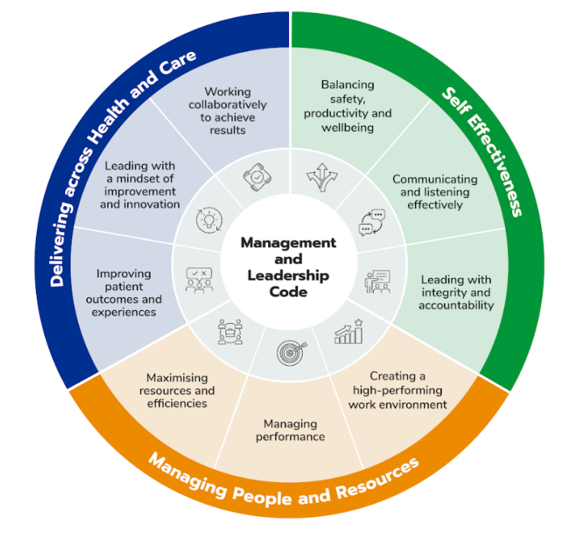
NHS Management and Leadership Framework
The vision of the NHS Management and Leadership Framework is “Empowering current and future leaders to excel, delivering outcomes and supporting staff in driving the shift towards patient-centred community and neighbourhood-based care, preventative strategies, and innovative, digitally-enabled services”.
The purpose is to “Equip NHS managers with a code of practice, defined set of standards and competencies, a national development curriculum, and practical, accessible learning resources to enable them to lead and manage with confidence, care, and consistency and elevate NHS management and leadership as a recognised professional discipline”.
A number of resources will support the framework, including:
A national appraisal framework
A digital self-assessment against the standards
360 feedback tool which will signpost to a suite of free, self-directed online learning, fully aligned to the standards at all levels
The draft can be found at: https://www.england.nhs.uk/wp-content/uploads/2025/09/item-8i-appendix-a-mgmt-and-leadership-full-draft-standards.pdf

Slide 12
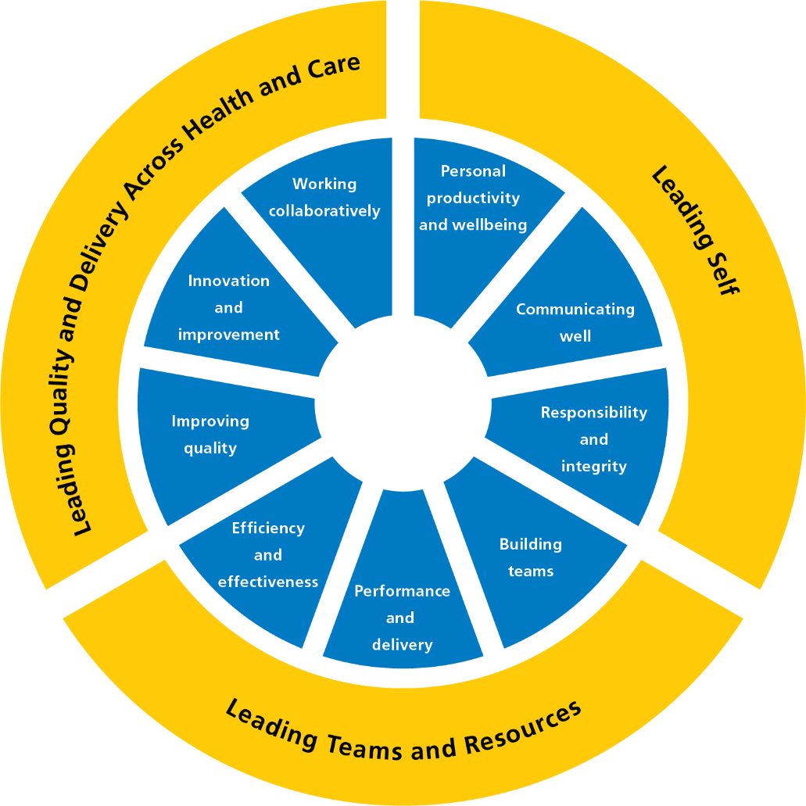
Oxleas ‘Our Leadership Way’
Our Leadership Way describes what good leadership looks like at Oxleas. It is our shared behavioural and cultural anchor for leadership, setting clear expectations for how we lead ourselves, our teams, and our system, every day.
Our Leadership Way aligns with the NHS England Management and Leadership Framework, a national framework that brings together leadership standards, competencies, and a code of practice for all NHS leaders. The framework applies to everyone with leadership or management responsibility, from those new to leadership through to executive roles, and provides a consistent national view of what good leadership looks like across the NHS.
At Oxleas, we have translated this national framework into language and behaviours that reflect our values, our culture, and our strategic priorities. Our Leadership Way connects the national expectations with what it means to lead well at Oxleas, ensuring leadership feels relevant, practical, and rooted in the Oxleas difference.

Slide 13
CQC Framework: Key Lines of Enquiry
Safe
Effective
Caring
Responsive
Well-led
Protect people from harm
Safeguarding
Risk management
Safe care
Medicines
Learning
Deliver evidence-based outcomes
Assess needs
Monitor outcomes
Skilled staff
Teamwork
Consent
Treat people with compassion
Respect & kindness
Involve people
Privacy & dignity
Meet individual needs
Person-centred
Equity of access
Timely care
Complaints
Ensure strong leadership
Leadership
Strategy
Culture
Governance
Improvement
This diagram summarises the five CQC Domains (Key Lines of Enquiry) and the sources of evidence for each of these.
Link to more detailed information: https://www.cqc.org.uk/guidance-providers/healthcare/key-lines-enquiry-healthcare-services

Slide 14
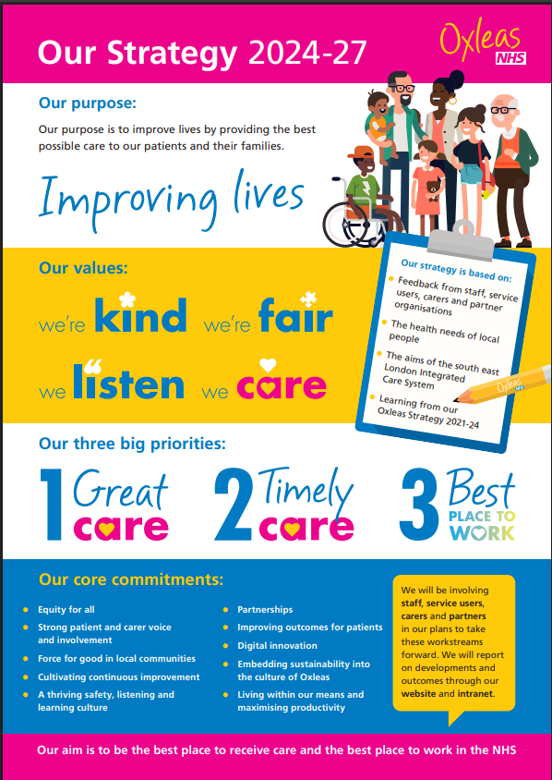
Oxleas Strategy 2024-27
Our journey to continually improving lives… With you in the driving seat
We want everyone, wherever located, to feel the ‘ Oxleas difference’ — a distinct culture that is driven by our unique values.
The key priorities for 2024 – 2027 have been extracted from your strategy below for reference:
Great Care: We want Oxleas to be known for kind and compassionate care that puts patients right at the centre. We want to draw on the best in research and practice to improve our patients’ lives. Wherever possible, we want to equip our patients with the tools, skills and services they need to manage their conditions in their own communities.
Timely Care: The lives of our patients improve when they receive the right care at the right time. When they experience unnecessary delays in receiving care, their health can deteriorate. We are committed to doing everything we can to prevent this.
Best Place to Work: Our ambition is for Oxleas to be the best place to work in the NHS. We know that we can only deliver really great care to our patients if we are able to retain and attract high quality and engaged staff. Given the acute NHS staffing challenges, it is more important than ever that Oxleas stands out as an employer of choice where everyone feels included.
For each strategic priority, Oxleas has a vision and key cross-organisational programmes of work that are essential for meeting the strategic priority and vision. These are outlined on the following pages.

Slide 15
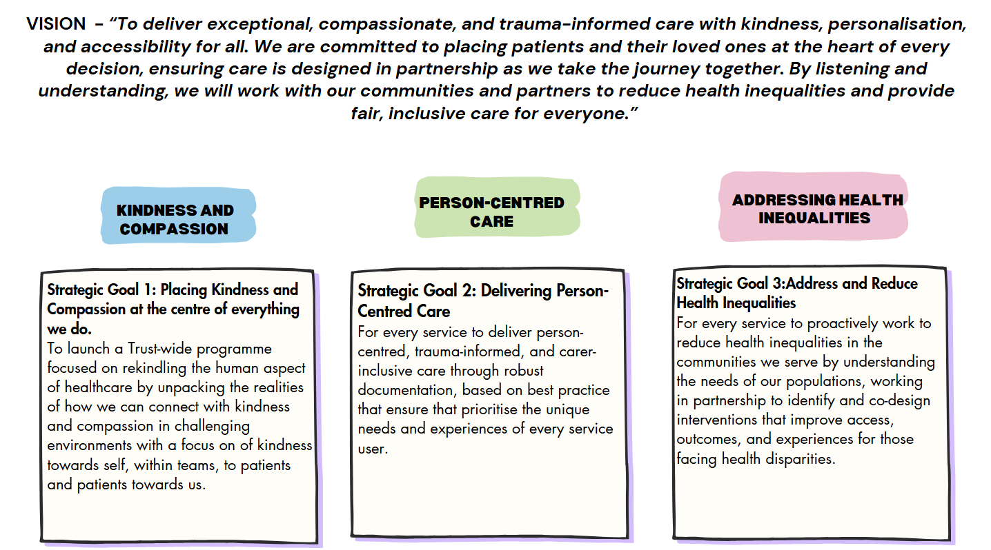
Oxleas Strategy: Great Care

Slide 16
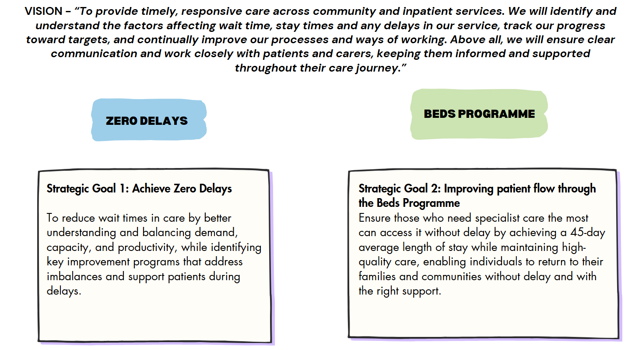
Oxleas Strategy: Timely Care

Slide 17
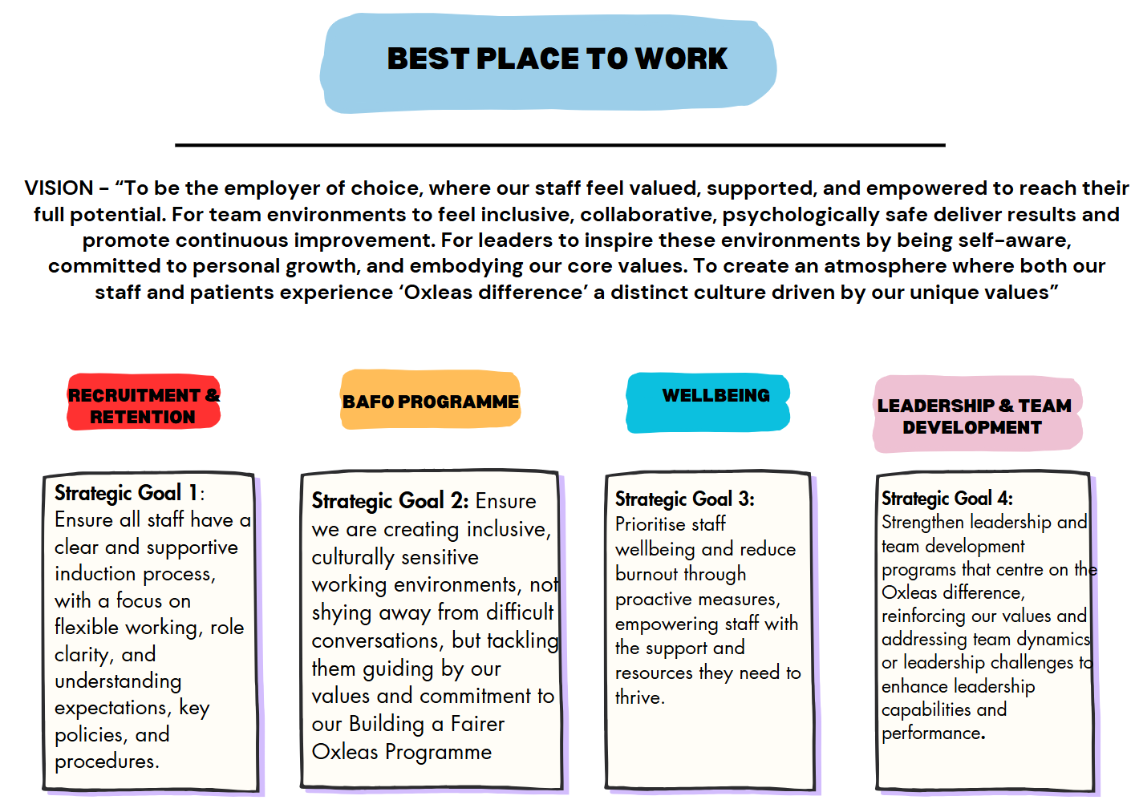
Oxleas Strategy: Best Place to Work

Slide 18
The GROW Model
The Goal, Reality, Options and Will (GROW) model is a widely used coaching model.
The Tricordant coaching faculty will use this model whilst working with you in our 1:1 coaching sessions and we will also discuss the value of the model and of the use of ‘coaching’ questions as part of your leadership approach throughout the programme.
References
Alexander, G. (2010). Behavioural coaching – The GROW model. In J. Passmore (Ed.), Excellence in coaching: The industry guide (pp. 83–93). Kogan Page
G
R
O
W
GOAL
Identify the desired outcomes or destination
What do you want to achieve?
Where do you want to be?
REALITY
Examine the current situation
Explore challenges, strengths and areas of opportunity
OPTIONS
Brainstorm potential strategies, solutions and paths to reach the goal
Try and think ‘out of the box’!
WILL
What specific steps will you take, and when?
How will you know you are making progress and stay accountable?

Slide 19
Additional Resources
Psychological Safety
https://www.ccl.org/articles/leading-effectively-articles/what-is-psychological-safety-at-work/
Action Learning (for this programme we have called this approach ‘activation learning’, but it is based on the same principles.)
https://www.actionlearningcentre.com/what-is-action-learning/
Adaptive Leadership – Blog – From the Dance Floor to the Balcony
https://www.newlevelwork.com/post/move-away-from-the-dance-floor-to-the-balcony
NHS Management and Leadership Framework
https://www.england.nhs.uk/wp-content/uploads/2025/09/item-8i-appendix-a-mgmt-and-leadership-full-draft-standards.pdf
CQC Assessment Framework
https://www.cqc.org.uk/guidance-providers/healthcare/key-lines-enquiry-healthcare-services

Slide 20
Module 1: Me as a Leader

Slide 21
Module 1 Overview
Module 1 focuses on building a strong foundation of self‑awareness as the starting point for effective leadership.
Participants will explore who they are as leaders, what motivates them, and how their values, identity and lived experience shape their leadership behaviour and impact on others
The module invites you to reflect on your personal leadership journey so far, increasing awareness of strengths, motivators, conflict responses and potential self‑sabotaging patterns. You will consider how emotional intelligence, presence and personal impact influence relationships, decision‑making and team climate from day one.
We will explore what is important in leadership and how to apply different ways of leading to different situations, with a focus on creating psychological safety through how you show up, listen and engage.
You will deepen your understanding of self and others, and you will finalise and commit to your leadership goals as an authentic leader.
By the end of this module, you will:
Gain more self-awareness around your own values and leadership style, so you can grow as a leader
Know what has shaped your leadership journey so far, both professionally and personally
Understand different leadership styles and their impact on people and teams
Learn how to create the best environment for you and others to thrive in
Know how you need to manage your own health and wellbeing to be the best leader you can be
Share your journey and commit to your leadership goal(s), making the first steps
Learn from peers to have a greater insight into self, others, value differences and considering impacts

Slide 22
Day 1: Agenda
Topic | Agenda Items
Start | 09:30 | Welcome and start
Welcome and Connecting | 09:30 – 09:45 | Welcome and introduction to the day
 | 09:45 – 10:15 | Connection together
Building a picture of who I am | 10:15 – 11:15 | Who am I at my best
 | 11:15 – 11:45 | What shapes me
 | 11:45 – 12:15 | What do I want to be known for
Lunch | 12:15 – 13:00 | Lunch
What leadership style do I want to be | 13:00 – 13:30 | What is important in leadership
 | 13:30 – 14:00 | What are the different ways of leading
How can I be an authentic leader | 14:00 – 14:45 | Deep dive into the day's topic
Break | 14:45 – 15:00 | Break
Finalising my leadership goals | 15:15 – 16:00 | Finalising my leadership goals
Reflections and Close | 16:00 - 16:30 | Reflections and Close

Slide 23
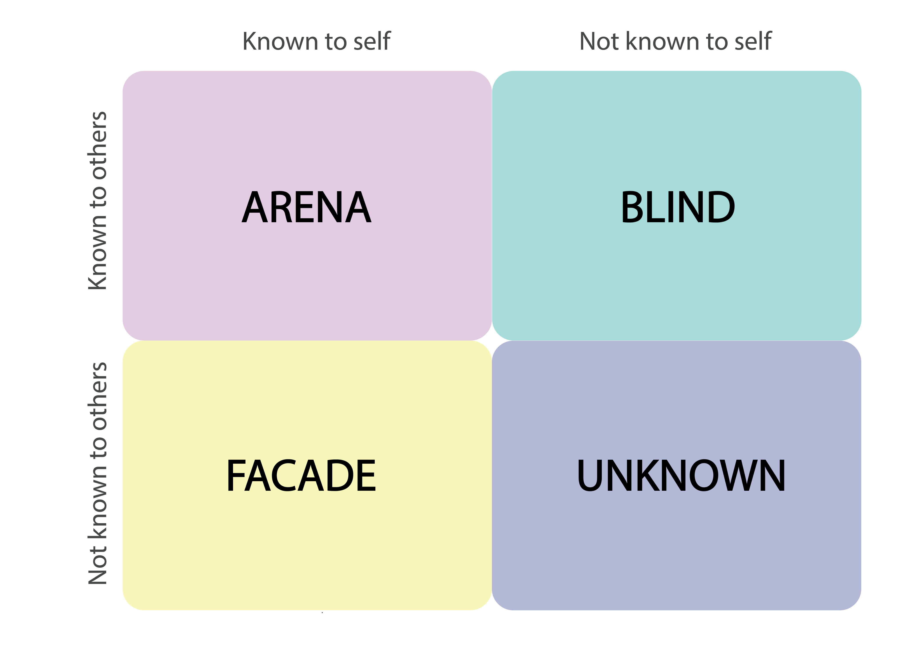
Johari Window
Feedback
The Johari Window is a self-awareness and communication framework divided into four quadrants (or panes):
Open Area: What you and others know about you.
Blind Spot: What others know about you, but you do not.
Hidden Area: What you know about yourself but choose not to share.
Unknown Area: What neither you nor others know yet.
The aim is to expand your Open Area through self-reflection, feedback, and trust-building, supporting personal and professional development.
Open Area
Blind Spot
Disclosure
Hidden Area
Unknown Area

Slide 24
Goleman’s Emotional Intelligence Model
Self Awareness
Social Awareness
How do I understand my thoughts and feelings and their effect on others?
Am I aware of my own strengths and limitations?
Do I have a strong sense of self worth?
Am I able to empathise with others?
How far am I aware of the needs and priorities of my organisation?
Do I understand the needs of patients, colleagues and partner organisations, and strive to meet these?
Goleman’s Emotional Intelligence Model
Self Management
Relationship Management
Can I control potentially distributive emotions and impulses?
How adaptable am I?
How important is achievement to me, and what kind of achievement matters the most?
Am I able to motivate myself?
How well do I manage my own stress?
Do I foster deep, lasting and meaningful relationships?
How far am I able to align with others and build collaborative teams?
Can I inspire and develop others?
How clear are my communications?
Can I identify and resolve conflict?

Slide 25
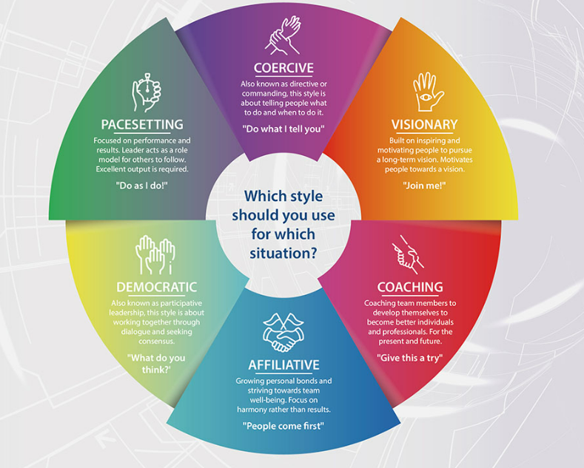
Golman’s Leadership Styles
Daniel Goleman’s six leadership styles are frameworks built on emotional intelligence.
Effective leaders avoid relying on just one; they fluidly shift between styles depending on the situation, the team’s needs, and organisational goals.

Slide 26
Preparation Activity: My Leadership Journey
Throughout the leadership development programme, you will be thinking about the leadership skills and behaviours you would like to develop.
A good way into this is to think about what has informed your leadership journey so far … the highs as well as some of things you wish you had done differently or had known more about at the time; the people and some of the events that took place.
Take some time to reflect on your journey into leadership. You can go back as far as you like– perhaps you were a natural leader as a child, or more recently you might have been encouraged to step into a leadership role or just knew that the time was right and so went for it! There are no rules – this is your journey.
And then, there is an opportunity to think into the future – how would you like that to pan out – use the template as a loose framework to help you plot this out.
We will work on these journeys during Module 1 as part of the ‘what shaped me’ session, so it would be helpful if you could do some thinking around this topic before this session. The templates on the next two pages are designed to help you with this task.

Slide 27




NOW
Key Roles
Key Events
Key People
What I was thinking & Feeling
Timeline

Slide 28
FUTURE LOOK
Key Roles
Key Events
Key People
What I was thinking & Feeling
Timeline

Slide 29
Additional Resources
Goleman’s Leadership Styles
https://content.leadershipacademy.nhs.uk/aspce3/files/Leadership_that_gets_results_goleman.pdf
Johari Window
https://www.hee.nhs.uk/sites/default/files/documents/Johari%20window.pdf
Podcasts
https://www.ted.com/talks/drew_dudley_everyday_leadership
https://www.ted.com/talks/karen_eber_how_your_brain_responds_to_stories_and_why_they_re_crucial_for_leaders We will be sharing our stories/leadership journeys at session 1

Slide 30
End of Document

